Slide 1
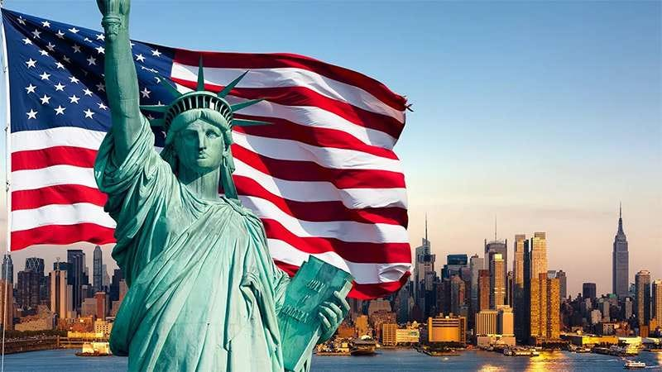
Keywords to Understand Present-Day America
Composed By: Hayato Ishida
For Japanese version, click here
Updated On: 16 July 2024

Slide 2
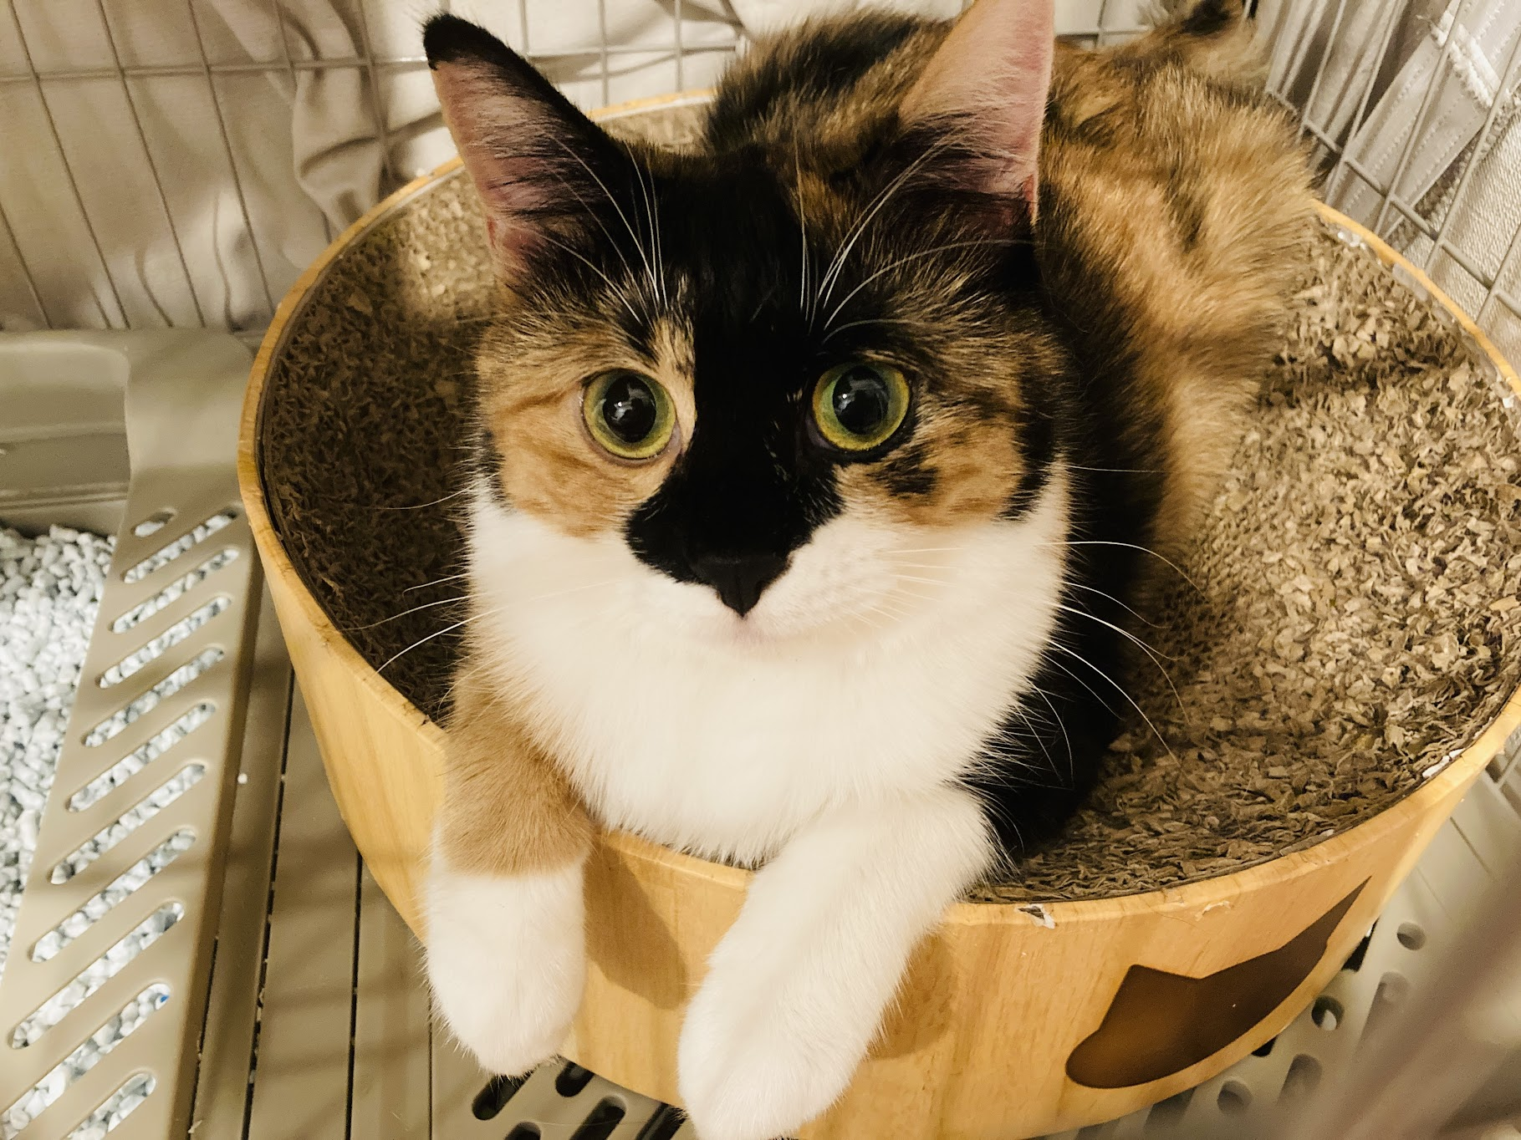
About Me
Accounts
GitHub: @hayat01sh1da
X: @hayat01sh1da
LinkedIn: @hayat01sh1da
Speaker Deck: @hayat01sh1da
Docswell: @hayat01sh1da
Occupation: Software Engineer
Things I Am Into
Linguistics
Singing at Karaoke
Listening to Music
Watching Movies
Cat Feeding

Slide 3
Licences / Certifications
English
TOEIC® Listening & Reading 915: Certified on December 2019
Engineering
Information Security Management: Certified on November 2017
Applied Information Technology Engineer: Certified on June 2017
Fundamental Information Technology Engineer: Certified on November 2016
IT Passport: Certified on April 2016
Others
Abacus 2nd Class: Certified on June 2002
Mental Arithmetic 3rd Class: Certified on February 2001

Slide 4
Skill Stack
Languages
Japanese: Native Proficiency
English: Full professional Proficiency
Development
Backend: Ruby(Ruby on Rails), Python
Frontend: TypeScript + React.js, TypeScript +Vue.js
Database: MySQL, PostgreSQL, MongoDB
Architecture: Monolith, Modular Monolith
Hosting: AWS ESK
Versioning: Git, GitHub
CI/CD: GitHub Actions, ArgoCD
Monitoring: Datadog, Sentry

Slide 5
Work Histories
Period | Genre | Position | Jobs
Aug 2021 - Present | Saas(Educational Service) | Software Engineer | Backend Development Frontend Development CI/CD Maintenance Weekly Release Manager Troubleshooting Documentation Technical Debt Resolution Tech Blog Entries LT Speaker
Feb 2020 - Dec 2020 | SaaS(Chatbot Platform) | Backend Engineer | Backend Development Documentation Technical Debt Resolution Inspection of Alternative API

Slide 6
International-Exchange Activities
Activities in University
English Linguistics Seminar(Focusing on Mass Media English)
International-Exchange Clubs(The 2nd Year)
International-Exchange Programmes conducted by Japan Cabinet Office(2013 - 2016)
Japanese Linguistics Course(The Final Year)
Overseas Life Experience
Working Holiday in Australia(April 2014 - March 2015)
Language School for 1 month in Sydney
Work for 6 Months in Hamilton Island Resort
Volunteering for 1 Month as Assistant Teacher of Japanese Language at St Ives High School in NSW
Other Activities
Keep Everyday Journal in English (April 2014 - Present)
Sunrise Toastmasters Club(February 2017 - March 2018)
Vital Japan(January 2018 - July 2019, October 2022 - February 2023)
Self Learning and Training of English Language
Participation Ruby-Related Tech Conferences

Slide 7
Agenda
Prologue
PC Terms 1 -Genders・Sexes・Diversity-
PC Terms 2 -Social Movements-
Highly Digitalised Society
Others
Summary
References

Slide 8
1. Prologue

Slide 9
1. Prologue
Definition of Present-Day America
The information as of 10 November 2018, when the 168th monthly session of Vital Japan whose theme was Learn Keywords to Interpret Present-Day America was held, presented by Mr. Satoshi Sugita, who was the lecturer at Practical Business English of NHK Radio and a visiting professor at Showa Women's University.

Slide 10
2. PC Terms 1 -Genders・Sexes・Diversity-

Slide 11
2. PC Terms 1 -Genders・Sexes・Diversity-
What Political Correctness Is
Political correctness (adjectivally: politically correct; commonly abbreviated PC) is a term used to describe language, policies, or measures that are intended to avoid offense or disadvantage to members of particular groups in society.
Reference: Political Correctness - Wikipedia

Slide 12
2. PC Terms 1 -Genders・Sexes・Diversity-
That is to say…
The United States of America is multi-ethnic and cultural state and there are as
many ways to interpret an expression or a description as various groups.
It is highly likely that a group is generous for it, but the other treat it as a taboo.
PC terms are necessary to express something sensitive without touching on taboos.

Slide 13
2. PC Terms 1 -Genders・Sexes・Diversity-
Original Descriptions | Politically Correct Terms | Backgrounds
Ladies and gentleman. | Good morning, passengers. (transport) Hello, everyone. (greetings) | Gender is not only male and female, and it must be inclusively treated.
neuter | non-binary | Complement of gender other than male and female. As of 2014, Facebook offers as many 58 gender options according to ABC News.
gender-free | gender-neuter gender-fluid | gender-free is absent on Oxford English Dictionary.
he she | xe ze | x or z masks gender still remaining some pronouns in Present-Day English.
they | e.g., Each child played with her or his parent. → Each child played with their parent. | Singular pronouns such as he or she exposes gender, so they is used to cover it.

Slide 14
2. PC Terms 1 -Genders・Sexes・Diversity-
Original Descriptions | Politically Correct Terms | Backgrounds
Mr. Mrs. Miss Ms. | Mx. | x masks gender. There is a precedent that a claimant sued a defendant over the title the claimant were unhappy to be called with.
foreign | e.g., foreign students → international students | It is likely to be exclusive when people are modified. However, non-living objects are exceptions such as foreign minister, foreign exchange, foreign reserve.
chairman anchorman | chairperson → chair anchorperson → anchor | The suffix -person is often omitted if what is mentioned is self-evident without it. ※ There is a case that rename of -man was legally approved.

Slide 15
2. PC Terms 1 -Genders・Sexes・Diversity-
Original Descriptions | Politically Correct Terms | Backgrounds
actor actress | actor | Covers relations between occupations and genders.
hero heroin | hero
waitress | waitperson, waitron → waitstaff
coed | student | Shorten form of coeducation and means a female student in a coeducational institution, especially in a college or university. The prefix co- suggests female students are subject to male students.

Slide 16
3. PC Terms 2 -Social Movements-

Slide 17
3. PC Terms 2 -Social Movements-
Original Descriptions | Politically Correct Terms | Backgrounds
global warming | climate change | Suggests this phenomenon is caused by call of nature, not by economical activities of human beings
slow children | slow down | Means to drive slowly as children will pass by. Adjective slow also means dull which seems quite insulting.
the disabled the handicapped | (To be discussed) | How to make the expression politically correct is still under discussion.

Slide 18
3. PC Terms 2 -Social Movements-
Original Descriptions | Politically Correct Terms | Backgrounds
Negro → black → Afro-American → African American → coloured people | people of colour | N-words is terribly discriminatory and the absolute taboo which is more dangerous than F-words. In 2018, an American Journalist Megyn Kelly was sucked by NBC for the scandal called Blackface comments and she lost her glorious career overnight.
flip chart | easel | flip is the insulting form of address to Filipino.
Christmas party | office party | Hanukkah is also an important ritual for Jewish people other than Christmas for Christians.
Oriental | Chinese | The insulting form of address to Chinese people
Jew | Jewish person | The insulting form of address to Jewish people. Akin to Jap to Japanese.

Slide 19
4. Highly Digitalised Society

Slide 20
4. Highly Digitalised Society
Politically Correct Terms | Meanings
friend | The verb is befriend and unfriend born in social networking services verbalized friend. The negative suffix -un has born sets of expressions like ↔ unlike, star ↔ unstar, flag ↔ unflag(Just like Newspeak in Nineteen-Eight Four).
ghosting | The act of disappearance in social networking services
trolling | The act of uploading unpleasant and inappropriate contents to social networking services to pull people's eyes. Videos shared by part-timers lacking in common sense on YouTube are familiar examples.
catfish | A villain who does a fraud act hiding their identity and impersonating someone else
always-on | The status which is active on social networking services at any time

Slide 21
4. Highly Digitalised Society
Politically Correct Terms | Meanings
text-neck | A distorted neck caused by posture keeping one's head downward
Instagrammable | Something attractive on social networking services
FOMO | Fear Of Missing Out The passive act to be afraid to fall behind the latest information and lose the best opportunity
JOMO | Joy Of Missing Out The antonym of FOMO. The aggressive act to control incoming information and take back joy of daily life
couch-potato | [Obsolete] Taking chips watching TV

Slide 22
5. Others

Slide 23
5. Others
Politically Correct Terms | Meanings
gender-neutral gender-fluid | transgender represents mismatch between sex and cognitive gender, but these terms means people who can be fascinated by all others beyond the concept of genders.
go postal → Run, Hide, Fight | Mass shooting. It used to often occur in post offices, but it has come to happen public spaces such as schools. Once it rises, run first, hide second and fight in the worst case, time not permitted.
senior moment | Dementia among the elderly. Elderly couples call each other by Darling and Honey. It looks so sweet for the third party, but they have actually forgot each other's name.

Slide 24
6. Summary

Slide 25
6. Summary
Personally, political correctness is somewhat too sensitive, but we must make sure where any land mine is buried. "I am awfully sorry, but I did not know it." never works in some situations, so it is wiser for us to keep up with this kind of affairs just in case.
The more developed technology becomes, the more likely new words is to show up. If we fail to catch up a discussion, it would be fatal at work. Even in small talks, we had better be familiar with worldwide political affairs. It is also wiser for us to keep up with this kind of matters to maximise the intersection of topics.

Slide 26
7. References

Slide 27
7. References
The 168th monthly session of Vital Japan - Learn Keywords to Interpret Present-Day America
Last Accessed On: 12 June 2022
Political Correctness - Wikipedia
Last Accessed On: 12 June 2022
Megyn Kelly apologizes for defending blackface Halloween costumes
Last Accessed On: 18 February 2024

Slide 28
EOD

